Slide 1

Agenda
Recap (15 mins)
Project Planning Techniques (30 mins)
Developing the Project Schedule (45 mins)
Agenda
Assignment Discussion (30 mins)

Slide 2
RECAP

Slide 3
Project Life Cycle or Project Process Groups
Initiation
Planning
Execution
Monitoring and Control
Closeout
Select project. Consider resources.
Articulate the benefits.
Prepare business case.
Assign project manager
Define requirements.
Define quality and quantities
Define resources Schedule activities
Direct and manage the work packages.
Execute the activities as per the schedule.
Track Progress
Compare actual against plan
Adjust plan if necessary
Verify work complete
Close contract
Admin closeout
Project Manager
Change Management and Stakeholder Management
Integration of activities
RESOURCES (Capital, Material, Equipment)
INTEGRATION PROCESSES
OUTPUT (Products, Services, Profit)
Notes:
The project manager according to Kerzner, (2013: 38) is responsible for coordinating and integrating activities across multiple functional lines. The integration of these activities include:
● Integrating the activities necessary to develop a project plan
● Integrating the activities necessary to execute the plan
● Integrating the activities necessary to make changes to the plan

Slide 4
Life Cycle for Project Management
Embryonic
Executive Management Acceptance
Line Management Acceptance
Growth
Maturity
Visible executive support
Use of life cycle phases
Development of a management cost control system
Recognise need
Line management support
Executive understanding of project management
Line management commitment
Development of a project management methodology
Integrate cost and schedule control
Recognise benefit
Line management education
Commitment to planning
Ongoing training to enhance project management skills
Recognise applications
Project Sponsorship
Recognise what must be done
Willingness to change ways of doing business
Willingness to release employees for project management training
Selection of a project tracking system
Notes:
shows the typical life-cycle phases that an organization goes through to implement project management. In the first phase, the Embryonic Phase, the organization recognizes the apparent need for project management. This recognition normally takes place at the lower and middle levels of management where the project activities actually take place. The executives are then informed of the need and assess the situation.

Slide 5
PLANNING

Slide 6
Reasons for project planning
The objective of planning is to completely define all work required usually through a scope of work document so that the plan is readily identifiable to each project participant.
To eliminate or reduce uncertainty
To improve efficiency of the operation
To obtain a better understanding of the objectives
To provide a basis for monitoring and controlling work
Notes:
Planning is a continuous process of making entrepreneurial decisions with an eye to the future, and methodically organizing the effort needed to carry out these decisions. Furthermore, systematic planning allows an organization of set goals.

Slide 7
The components of the planning phase
Objective
Program
Schedule
Budget
Forecast
Organization
Policy
Procedure
Standard
Goal or Target
Strategy and Major Actions
Plan with activities and dates
Planned Expenditure
Projection
Organogram
General Guide for activities
Detailed method of policy
Acceptable level of performance
Notes:
1. Objective: a goal, target, or quota to be achieved by a certain time
2. Program: the strategy to be followed and major actions to be taken in order to
3. achieve or exceed objectives
4. Schedule: a plan showing when individual or group activities or accomplishments will be started and/or completed
5. Budget: planned expenditures required to achieve or exceed objectives
6. Forecast: a projection of what will happen by a certain time
7. Organization: design of the number and kinds of positions, along with corresponding duties and responsibilities, required to achieve or exceed objectives
8. Policy: a general guide for decision-making and individual actions
9. Procedure: a detailed method for carrying out a policy
10. Standard: a level of individual or group performance defined as adequate or acceptable.

Slide 8
Life Cycle for Project Management
Feasibility Report. Used to decide whether or not to commit resources for the subsequent phases
Scope of Work. The project cannot proceed to the next phase unless the SOW is comprehensive and management has approved.
G1
G2
Conceptualisation
Feasibility
Pre planning
Detail Planning
Execution
Testing/Commissioning
Plan project and implementation activities
Estimate resource requirements
Identify cost and consequences and alternatives
Define requirements.
High Level Scope of Work
Contractor tasks
Support
Schedule of performance
G3
Define the problem
Identify potential solutions
Detailed Scope of Work
Project specifications.
Milestone Schedule
Work Breakdown Structure
Negotiate for team members.
Direct and manage the work.
Track progress.
Test and analyse performance.
Closeout reports.
Handover
Project Specification. Must be signed of by a registered professional.
Notes:
shows the typical life-cycle phases that an organization goes through to implement project management. In the first phase, the Embryonic Phase, the organization recognizes the apparent need for project management. This recognition normally takes place at the lower and middle levels of management where the project activities actually take place. The executives are then informed of the need and assess the situation.

Slide 9
Feasibility Report Checklist
Summary Level
Detail Level
Evaluate alternatives
Evaluate market potential
Evaluate cost effectiveness
Evaluate producibility
Evaluate technical base
A more specific determination of the problem
Analysis of the state-of-the-art technology
Assessment of in-house technical capabilities
Test validity of alternatives
Quantify weaknesses and unknowns
Conduct trade-off analysis on time, cost, and performance
Prepare initial project goals and objectives
Prepare preliminary cost estimates and development plan
Notes:
The end result of the feasibility study is a management decision on whether to terminate the project or to approve its next phase. Although management can stop the project at several later phases, the decision is especially critical at this point, because later phases require a major commitment of resources.

Slide 10
Pre-Planning/Defining the requirements
● General scope of the work
● Objectives and related background
● Contractor’s tasks
● Contractor end-item performance requirements
● Reference to related studies, documentation, and specifications
● Data items (documentation)
● Support equipment for contract end-item
● Customer-furnished property, facilities, equipment, and services
● Customer-furnished documentation
● Schedule of performance
● Exhibits, attachments, and appendices
Notes:
The end result of the feasibility study is a management decision on whether to terminate the project or to approve its next phase. Although management can stop the project at several later phases, the decision is especially critical at this point, because later phases require a major commitment of resources.

Slide 11
Detailed Planning
Scope
Specifications
Milestone
WBS
● Scope
● Project Scope
● Scope Statement
● Statement of Work
Description | Spec. No
Civil | 100
Concrete | 101
Roofing | 102
Plumbing | 103
● Start dates
● End dates
● Major milestones
● Minor milestones
● Tasks
● Sub-tasks
● Time
● Costs
● Responsibilities
Notes:
Scope: This is the summary of all the deliverables required for the project, such as products, services and results.
• Project Scope: This entails work that must be completed in order to achieve the final scope of the project such as products, services and end results.
• Scope Statement: This is document that provides the foundation of making future decisions such as scope changes. The purpose of the document is to ensure that all stakeholders have common knowledge of the project scope. The scope statement contains the objectives, description of deliverables, end results and justification of the project. The scope statement seeks to address seven questions: who, what, when, why, where, how and how many. The document validates the project scope against the statement of work provided by the customer.
• Statement of work: This is a description that narrate the end results to be provided under the contract. The statement of work (SOW) is a narrative description of the work required for the project. The complexity of the SOW is determined by the desires of top management, the customer, and/or the user groups.

Slide 12
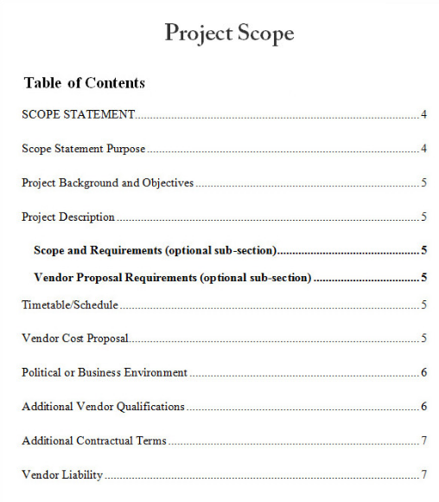
Example of SOW

Slide 13
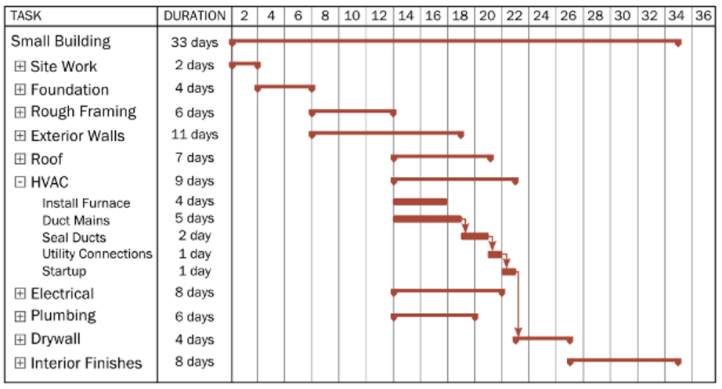
Example of Milestone Schedule

Slide 14
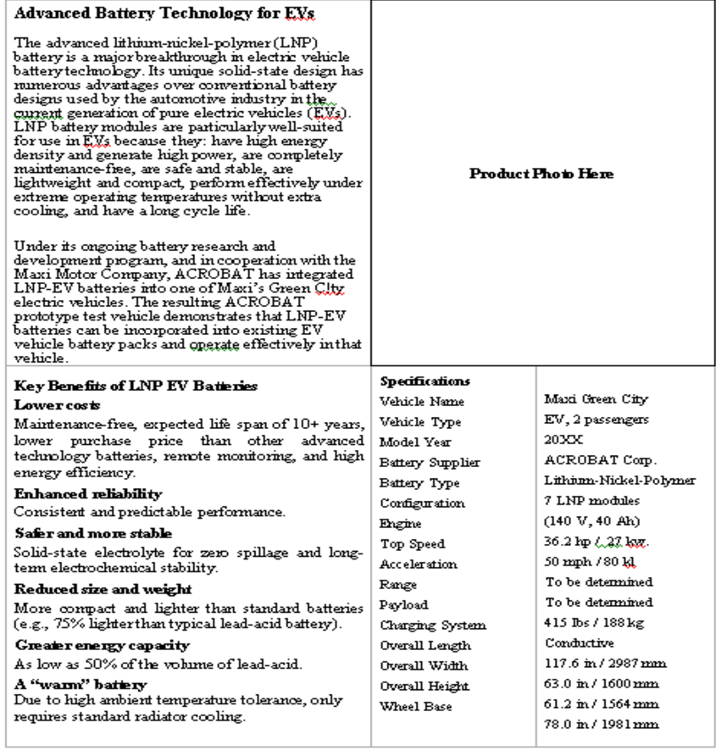
Example of Specification document

Slide 15
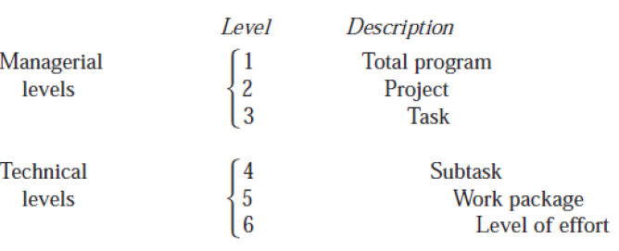
WBS
Build house
Design; Construct
Foundation, Walls, Roof
Mark up, Trenching, Concrete
Plot layout, Dig Foundation
Day 1, Dig west side, Day 2 dig east side
The top three levels of the WBS reflect integrated efforts and should not be related to one specific department. Effort required by departments or sections should be defined in subtasks and work packages.
Each element of work should be assigned to one and only one level of effort.
The summation of all elements in one level must be the sum of all work in the next lower level.

Slide 16
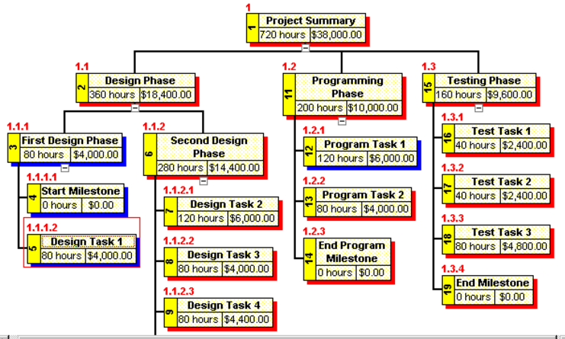
Example of a WBS

Slide 17
Activity 1
What are some of the misinterpretations that can arise from poorly written SOW documents?
Notes:
• Mixing Tasks, specifications, approvals and special instructions,
• Using imprecise language (nearly, optimum, approximately etc.)
• Lack of a pattern, structure or chronological order,
• Wide variation in size of tasks,
• Wide variation in how to describe details of the work,
• Failing to get third party review.

Slide 18
PROJECT SCHEDULE

Slide 19
Scheduling Techniques
The objective of planning is to completely define all work required usually through a scope of work document so that the plan is readily identifiable to each project participant.
● Gantt or bar charts
● Milestone charts
● Networks
● Program Evaluation and Review Technique (PERT)
● Arrow Diagram Method (ADM)
● Precedence Diagram Method (PDM)
Notes:
The end result of the feasibility study is a management decision on whether to terminate the project or to approve its next phase. Although management can stop the project at several later phases, the decision is especially critical at this point, because later phases require a major commitment of resources.

Slide 20
Activity 1
What is critical path?
What is slack time?
Notes:
Critical Path: This is the longest path through the network and determines the duration of the project. It is also the shortest amount of time necessary to accomplish the project.
slack is the amount of time that a task in a project network can be delayed without causing a delay to: subsequent tasks ("free float") project completion date
It refers to the difference between the late and early start times of an activity.

Slide 21
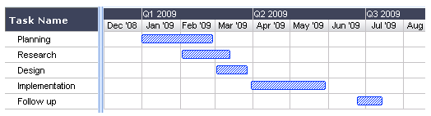
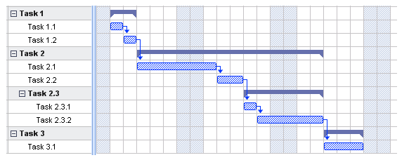
GANTT CHART
What is a Gantt Chart?
Shows you what has to be done (the activities/task) and when (the schedule)
Use it during status update meetings, reports, etc.
How to…
Determine what tasks must be done
Determine when each task should begin and ends
List the activities in chronological order
Visualise how long each activity is scheduled to last
Why is this useful?
Clarity. Ability to boil down multiple tasks and timelines into a single view/document.
Communication. Easy, visual method to help team members understand what must be done when.
Time management & coordination. Helps teams understand the overall impact of project delays and can foster stronger collaboration while encouraging better task organization
Efficiency. For instance, while one team member waits on the outcome of three other tasks before starting a crucial piece of the assignment, he or she can perform other project tasks.
Accountability. Use it during critical projects to track team progress, highlighting both big wins and major failures.
Simple Gantt chart
Gantt chart showing tasks and sub-tasks

Slide 22
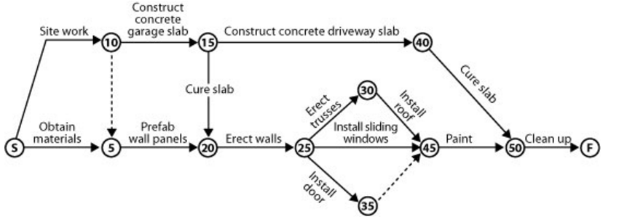
PERT CHART
Notes:
● All of the individual tasks to complete a program must be clear enough to be put down in a network, which comprises events and activities; i.e., follow the work breakdown structure.
In this diagram the actual activities to be carried out are written on the arrows. The activities are set out numerically which allows for sub-events to happen in between. Gaps are left between the numbers in the nodes (circles) to allow the sub-events to fit in. On large building sites these numbers may count in 20s or 50s or even 100s, whilst on smaller jobs these could be actual days within the construction program.

Slide 23
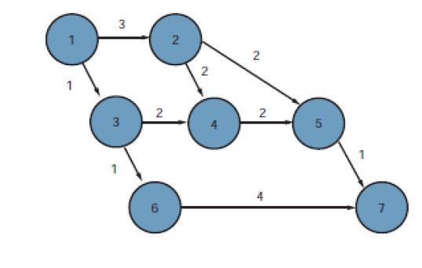
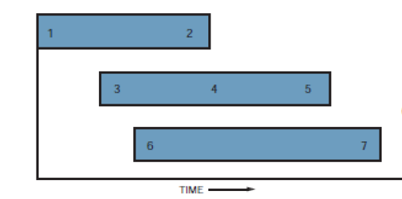
Conversion from GANTT to PERT
GANTT
PERT
Notes:
● All of the individual tasks to complete a program must be clear enough to be put down in a network, which comprises events and activities; i.e., follow the work breakdown structure.
In this diagram the actual activities to be carried out are written on the arrows. The activities are set out numerically which allows for sub-events to happen in between. Gaps are left between the numbers in the nodes (circles) to allow the sub-events to fit in. On large building sites these numbers may count in 20s or 50s or even 100s, whilst on smaller jobs these could be actual days within the construction program.

Slide 24
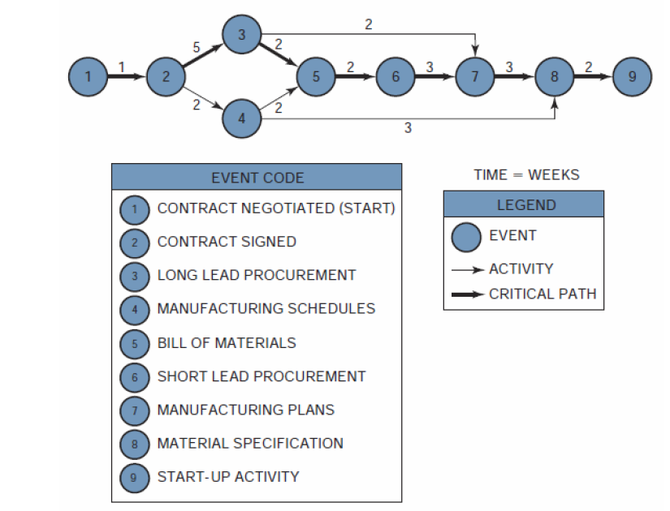
PERT Diagram
TE = 3
TL = 6
Slack = 6 -3 = 3
TE = the earliest time (date) on which an event can be expected to take place
TL= the latest date on which an event can take place without extending the completion date of the project
Slack time = TL -TE
Notes:
Since there exists only one path through the network that is the longest, the
other paths must be either equal in length to or shorter than that path. Therefore, there must exist events and activities that can be completed before the time when they are actually needed. The time differential between the scheduled completion date and the required date to meet critical path is referred to as the slack time. In Figure 3.4, event 4 is not on the crucial path. To go from event 2 to event 5 on the critical path requires seven weeks taking the route 2–3–5. If route 2–4–5 is taken, only four weeks are required. Therefore, event 4, which requires two weeks for completion, should begin anywhere from zero to three weeks after event 2 is complete.
Event 1 serves as the reference point for the network and could just as easily have been defined as a calendar date. As before, the critical path is represented as a bold line. The events on the critical path have no slack (i.e., TL =TE) and provide the boundaries for the noncritical path events.5 Since event 2 is critical, TL = TE 3 + 7= 10 for event 5. Event 6 terminates the critical path with a completion time of fifteen weeks.
The earliest time for event 3, which is not on the critical path, would be two weeks (TE 0 + 2= 2), assuming that it started as early as possible. The latest allowable date is obtained by subtracting the time required to complete the activity from events 3 to 5 from the latest starting date of event 5. Therefore, TL (for event 3) =10 - 5 = 5 weeks. Event 3 can now occur anywhere between weeks 2 and 5 without interfering with the scheduled completion date of the project. This same procedure can be applied to event 4, in which case TE 6 and TL 9.

Slide 25
Activity 2
What is the earliest completion time for the project?
What is earliest start time for activity 4?
What is the late start time for activity 4?
What is the early finish time for acivity 4?
What is the late finish time for activity 4?
Notes:
To make full use of the capabilities of PERT/CPM, we could identify four values:
● The earliest time when an activity can start (ES)
● The earliest time when an activity can finish (EF)
● The latest time when an activity can start (LS)
● The latest time when an activity can finish (LF).
To calculate the earliest starting times, we must make a forward pass through the network (i.e., left to right). The earliest starting time of a successor activity is the latest of the earliest finish dates of the predecessors. The earliest finishing time is the total of the earliest starting time and the activity duration.

Slide 26
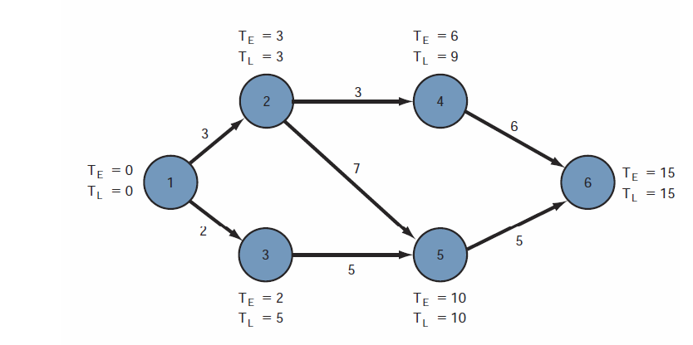
Example 2

Slide 27
ASSIGNMENT

Slide 28
Project – Ticketing software replacement
Phases – Design, Test, Build, Deploy, Support
Departments = Computing and Network; Information Services; Instruction and Research; User Support Services
Timeline = 6 months
Phase 1 = Team collected requirments (Prefeasibility or Conceptualisation – options were explored and discussed at meetings. Information gathering took 3 months. Decision – replace remedy with Request Tracker.
Phase 2 Migration – Moving only some departments from Remedy to RT. (Resources – Ron Himself –team lead plus Harry plus one programmer from Harrys group.
Ron – team lead plus create user interface
Harry and team – replace remedy, patch, update etc.
The transition was done by November of that year, one month sooner than the expected schedule of six months.
We need to fix the ticketing system

Slide 29
1.1
Replace ticket system
Conceptualise
Feasibility
Migration
Training
Gather requirements
Design
Investigate Solutions
Per departmetns
Build
Brainstorming
Meetings
Conduct weekly meeting
Test
Research
Articles
White papers

Slide 30
1.2
Categorise the risks; identify the risks,
• Technical
• Schedule
• Cost
• Human resources
• External
• Sponsor/customer
Analyse and quantify the risk
Market or price risk
Interest rates risk
Liquidity
Legal risk
Operational risk
Rate the risk in terms of
Frequency
Severity
Multiply the frequency by the severity
Prioritise the ratings
• Eliminate risk.
• Mitigate risk.
• Deflect risk.
• Accept risk (contingency).
• Turn risk into an opportunity.

Slide 31
MONITORING AND EVALUATION

Slide 32
Reasons for project planning
Graphs and charts are intended to communicate project progress to an intended audience. The final form of the schedule may be:
Bar chart
Graphs
Tables
Bubble Charts
Logic Diagrams

Slide 33
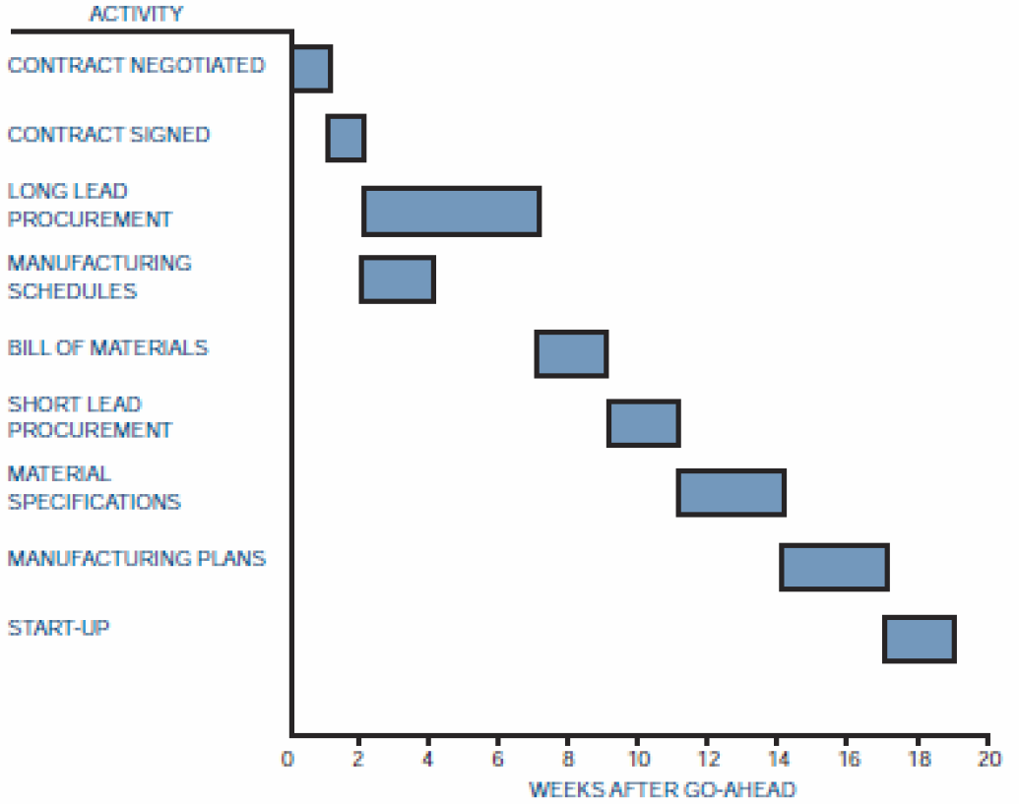
Bar Chart
Notes:
Bar charts provide only a vague description of how the entire program or project
reacts as a system, and have three major limitations. First, bar charts do not show the interdependencies of the activities, and therefore do not represent a “network” of activities.
The second major discrepancy is that the bar chart cannot show the results of either an early or a late start in activities.
The third limitation is that the bar chart does not show the uncertainty involved in performing the activity and, therefore, does not readily admit itself to sensitivity analysis.

Slide 34
PROJECT COST MANAGEMENT

Slide 35
Pricing Strategies
Type 1 Acquisition
Type 2 Acquisition
Develop cost model and estimating guidelines; design proposed project baseline for minimum cost to minimum customer requirements
Estimate cost realistically for minimum requirements.
Scrub the baseline. Squeeze out unnecessary costs.
Determine realistic minimum costs.
Adjust cost estimate for risks.
Add margin and determine price.
Compare price to customer budget.
Bid only if price within competitive range
Design project baseline compliant with customer requirements with innovative features but minimum risk
Estimate costs realistically.
Scrub baseline. Squeeze out unnecessary costs.
Determine “should cost” including risk adjustment.
Compare final cost estimate to customer budget and the most likely winning price.
Determine gross margin. This could be negative.
Decide whether gross margin is acceptable.
Determine the most likely bid price
If the bid price is below cost – provide explanation of source of additional funds.
Notes:
Frequently, however, one of two situations prevail when one is pursuing project acquisitions competitively.

Slide 36
Estimates
Order of magnitude
Approximate
Definitive
No detailed data
Accuracy of 35%
Top down approach
Based on statistical
May use historical data
Top-down
No detailed data
Based on similar projects
Adjust for capacity
Adjust for technology
Well defined data
Includes vendor quotes
Complete plans
Detailed specifications
Accuracy of 5%
Notes:
You contact a construction contractor who informs you that the parametric or statistical cost for a home in this suburb is $120 per square foot. In Los Angeles, the cost may be $4150 per square foot.
This type of estimate is prorated from previous projects that are similar in scope and capacity, and may be titled as estimating by analogy, parametric curves, rule of thumb, and indexed cost of similar activities adjusted for capacity and technology.

Slide 37
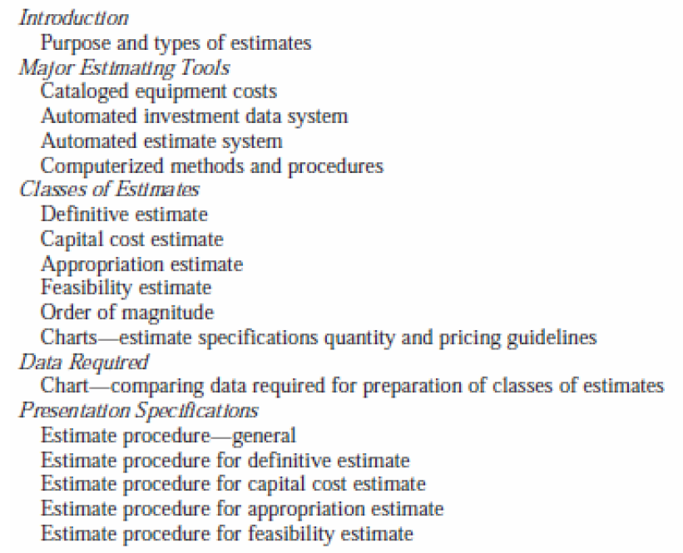
Estimating Manual Table of Contents
Notes:
Not all companies can use estimating manuals. Estimating manuals work best for repetitive tasks or similar tasks that can use a previous estimate adjusted by a degree-of difficulty factor. Activities such as R&D do not lend themselves to the use of estimating manuals other than for benchmark, repetitive laboratory tests.

Slide 38
Pricing Process
Activity Schedule
Work Breakdown Structure
Cost data
Price
Notes:
. The work breakdown structure and activity schedules are priced out through the lowest pricing units of the company. It is the responsibility of these pricing units, whether they be sections, departments, or divisions, to provide accurate and meaningful cost data (based on historical standards, if possible). All information is priced out at the lowest level of performance required, which, from the assumption of Chapter 3, will be the task level.

Slide 39
Work Breakdown Structure – Apex Manufacturing
PROGRAM
(01-00-00): Assembly Line Modification
PROJECT 2
(01-02-00): Assembly
PROJECT 1
(01-01-00): Initial Planning
Task 1
(01-01-01): Engineering Control
Task 2
(01-01-02): Engineering Development
Task 1
(01-02-01): Modification
Task 2
(01-02-02): Testing
Notes:
. The work breakdown structure and activity schedules are priced out through the lowest pricing units of the company. It is the responsibility of these pricing units, whether they be sections, departments, or divisions, to provide accurate and meaningful cost data (based on historical standards, if possible). All information is priced out at the lowest level of performance required, which, from the assumption of Chapter 3, will be the task level.

Slide 40
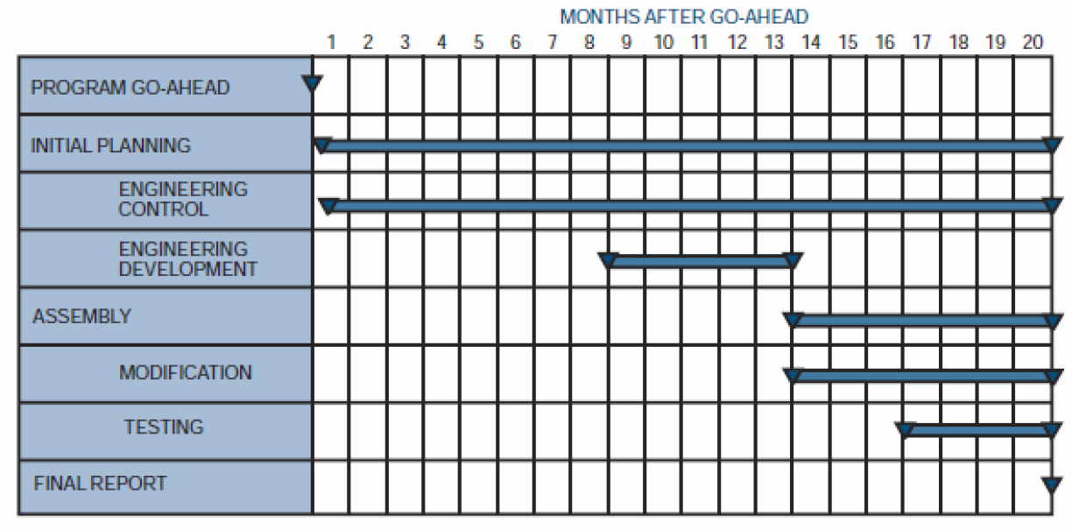
Work Breakdown Structure – Apex Manufacturing
Notes:
After the planning and pricing charts are approved by program team members and program managers, they are entered into an electronic data processing (EDP) system as shown in Figure 5.4. The computer then prices the hours on the planning charts using the applicable department rates for preparation of the direct budget time plan and estimate- at-completion reports. The direct budget time plan reports, once established, remain the same for the life of the contract except for customer-directed or approved changes or when contractor management determines that a reduction in budget is advisable

Slide 41
Types of costs
Fixed Costs: These costs stay the same and do not change throughout the project life cycle. Examples of fixed costs include setup costs, rental costs etc.
Variable Costs: Variable costs are costs that change with the amount of work. Examples of variable costs are hourly labor, the cost of material, the cost of supply, fuel for bulldozer etc.
Direct Costs: Direct costs are expenses that are billed directly to the project. Examples of direct costs are team travel expenses, team wages, the cost of material used in a project, costs incurred for materials used to construct a building.
Indirect Costs: Indirect costs are costs that are shared and allocated among several or all projects. Examples include fringe benefits and taxes. Another example of indirect costs could be the salary of an architect or a project manager who is partially allocated across many projects.
Sunk Costs: Sunk costs are costs that have been incurred on a project but have not produced value towards the project objectives. Sunk costs are like spilled milk.If they are unrecoverable, they are to be treated as if they are irrelevant.
Overhead Costs: Overhead costs are those general costs that are the costs of doing business not directly attributed to any one individual. They are shared proportionally across the project as a percentage. Eg. Telephone, office expenses.
Notes:
As an example lets say a contractor does R1m business for the year. He calculates that his running expenses is 100000 then his overhead cost is 10%

Slide 42
Project Financing Methods
Payback Period
Discounted Cash Flow (DCF)
Net Present Value (NPV)
Internal Rate of Return (IRR)
Notes:
As an example lets say a contractor does R1m business for the year. He calculates that his running expenses is 100000 then his overhead cost is 10%

Slide 43
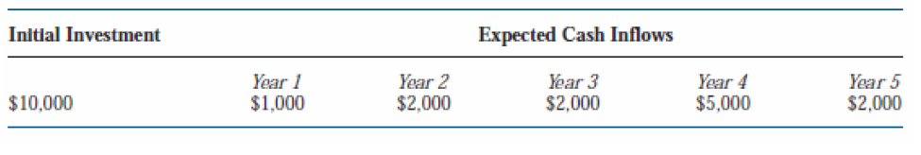
Payback period
The payback period is the exact length of time needed for a firm to recover its initial investment as calculated from cash inflows. Payback period is the least precise of all capital budgeting methods because the calculations are in rands and not adjusted for the time value of money.
Notes:
Project A will last for exactly five years with the cash inflows
shown. The payback period will be exactly four years. If the cash inflow in Year 4 were $6,000 instead of $5,000, then the payback period would be three years and 10 months.

Slide 44
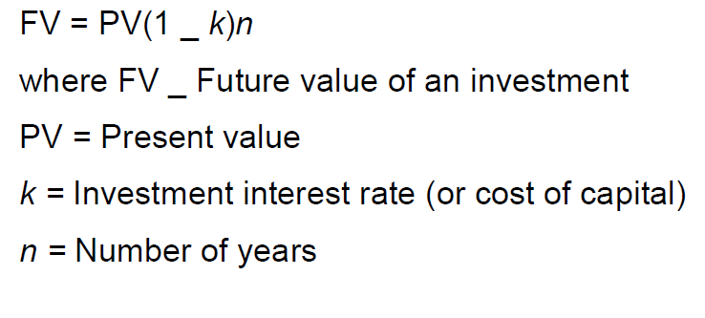
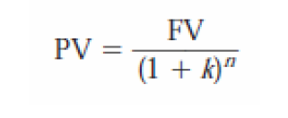
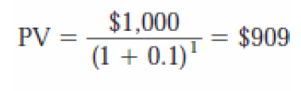
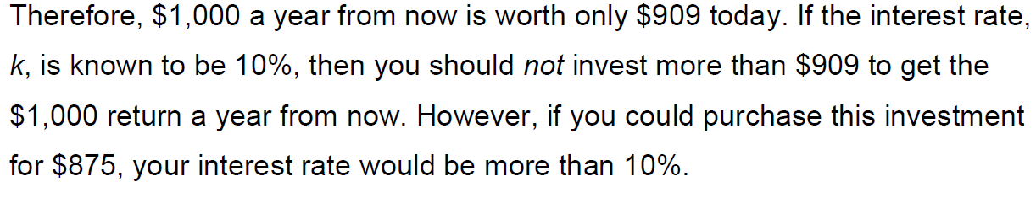
Discounted Cash Flows
Notes:
The problem with the payback method is that $5,000 received in Year 4 is not worth $5,000 today. This unsophisticated approach mandates that the payback method be used as a supplemental tool to accompany other methods.
5.11.2

Slide 45
Exercise
Investment A will generate $100,000 two years from now and investment B will generate $110,000 three years from now. If the cost of capital is 15%, which investment is better?
Notes:
PVA = $75,614
PVB = $72,327
This implies that a return of $100,000 in two years is worth more to the firm than a $110,000 return three years from now.

Slide 46
Exercise
Investment A will generate $100,000 two years from now and investment B will generate $110,000 three years from now. If the cost of capital is 15%, which investment is better?
Notes:
PVA = $75,614
PVB = $72,327
This implies that a return of $100,000 in two years is worth more to the firm than a $110,000 return three years from now.

Slide 47
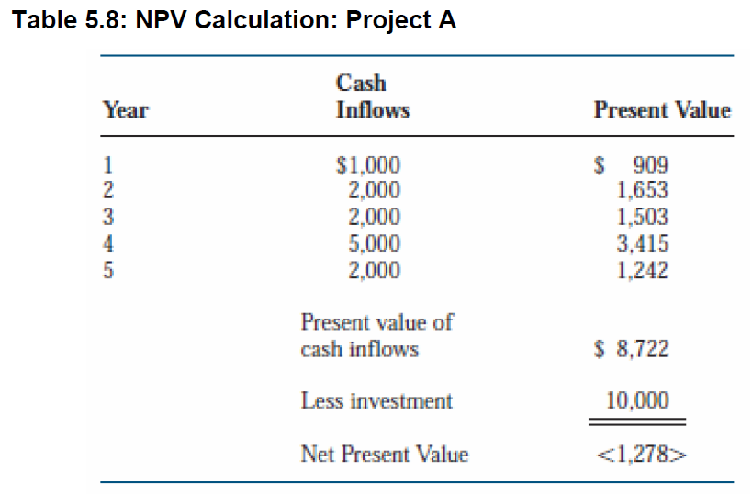
Net Present Value
the present value of future cash minus the present value of the cost of the investment. The formula is NPV = PV - cost
Notes:
This indicates that the cash inflows discounted to the present will not recover the initial investment. This, in fact, is a bad investment to consider. Previously, we stated that the cash flow stream yielded a payback period of four years.
● If the NPV is greater than or equal to zero dollars, accept the project.
● If the NPV is less than zero dollars, reject the project.
A positive value of NPV indicates that the firm will earn a return equal to or greater than its cost of capital.
PVA = $75,614
PVB = $72,327
This implies that a return of $100,000 in two years is worth more to the firm than a $110,000 return three years from now.

Slide 48
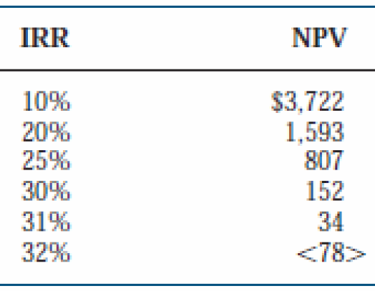
Internal Rate of Return
Is the discount rate where the present value of the cash inflows exactly equals the initial investment. The solution to problems involving IRR is basically a trial-and-error solution. The example below shows that with the cash inflows provided, and with a $5,000 initial investment, an IRR of 10% yielded a value of $3,722 for NPV. Therefore, as a second guess, we should try a value greater than 10% for IRR to generate a zero value for NPV.
Notes:
The table implies that the cash inflows are equivalent to a 31% return on investment. Therefore, if the cost of capital were 10%, this would be an excellent investment. Also, this project is “probably” superior to other projects with a lower value for IRR.

Slide 49
Comparing IRR, NPV and Payback
For most projects, both IRR and NPV will generate the same accept /reject decision. The major problem is the differences in the magnitude and timing of the cash inflows.
NPV assumes that the cash inflows are reinvested at the cost of capital
IRR assumes reinvestment at the project’s IRR. NPV tends to be a more conservative approach.
Notes:
The table implies that the cash inflows are equivalent to a 31% return on investment. Therefore, if the cost of capital were 10%, this would be an excellent investment. Also, this project is “probably” superior to other projects with a lower value for IRR.

Slide 50
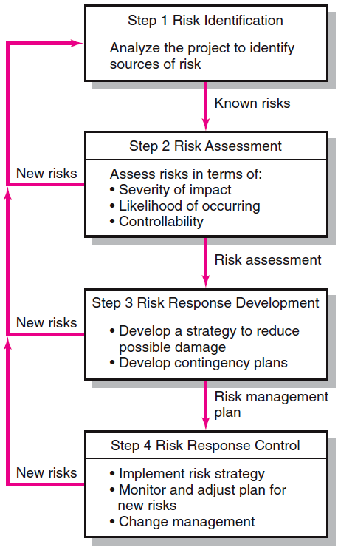
Risk Management Process
Generate a list of possible risks through
brainstorming,
historical data,
risk profiling.
Conduct scenario analysis for event probability and impact.
Compile risk assessment matrix
Conduct Failure Mode and Effects Analysis (FMEA)
Mitigate the risk
Avoid the risk
Transfer the risk
Retain the risk
Execute risk response strategy
Initiate contingency plans
Watch for new risks
Repeat risk identification exercise
Document risk resolution
Notes:
As an example lets say a contractor does R1m business for the year. He calculates that his running expenses is 100000 then his overhead cost is 10%

Slide 51
Quantifying risk
Assign a category for the frequency
Assign a category for the severity
Multiply the frequency value by the severity value.
Prioritise the ratings
Notes:
As an example lets say a contractor does R1m business for the year. He calculates that his running expenses is 100000 then his overhead cost is 10%

Slide 52
Responding to the risk
Eliminate risk.
Mitigate risk.
Deflect risk.
Accept risk (contingency).
Turn risk into an opportunity.
Notes:
As an example lets say a contractor does R1m business for the year. He calculates that his running expenses is 100000 then his overhead cost is 10%

Slide 53
Risk Prioritisation Analysis
Example: Severity Impact Assessment
 |  | Technical Performance | Cost | Schedule
5 Severe | Severe impact on achieving desired results. One or more critical objectives will not be achieved. | Performance unacceptable. Does not meet requirements. | Program budget impacted by greater than 50% | Increase critical path schedule by more than 3 months.
4 Significant | Significant impact on achieving desired results. One or more objectives will fall below acceptable levels. | Performance unacceptable . Significant changes required. | Program budget impacted between 30 and 49% | Increase critical path schedule by 2-3 months.
3 Moderate | Moderate impact on achieving desired results. | Performance below goals. Moderate changes required. | Program budget impacted between 10 and 29% | Increase critical path schedule by 1- 2 months.
2 Minor | Minor impact on achieving desired results. | Performance below goals but within acceptable limits. No changes required. | Program budget impacted between 0 and 9% | Increase critical path schedule by 0- 1 month.
1 Minimal | Little or no impact on achieving desired results. | Minor performance trade-offs. | Program budget not impacted. | Schedule not affected

Slide 54
Risk Matrix
A Risk matrix is a matrix that is used during risk assessment to define the various levels of risk as the product of the probability and severity categories. This is a simple mechanism to increase visibility of risks and assist management decision making.
Risk (R) = Severity x Probability x Frequency or R = S x P x F
Severity: Describes the potential loss or consequence or a mishap.
1=none or slight 2=Minimal 3=Significant 4=Major 5=Catastrophic Probability:
Probability: Describes the likelihood that the risk event will occur.
1=Impossible or remote under normal conditions 2=Unlikely under normal conditions 3=50/50 chance 4=Greater than 50% chance 5=Very likely Exposure:
Frequency: Describes the amount of time, number of cycles involved.
1=None or below average 2=Average 3=Above average 4=Great

Slide 55
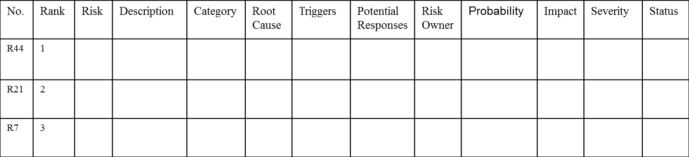
Sample Risk Register

Slide 56
Case Study
You have been appointed as the project manager for a shopping centre construction project. The area in which you are building is prone to excessive rain and occasional flooding. You are working with unfamiliar construction teams. After initial consultation with the local traffic department, it has become clear that they are not satisfied with the road layout as per your building plans. However, they did give the preliminary go-ahead for the project, with the proviso that the town engineer and town planner reconsider the plans. To date, all the suppliers you have contacted can supply all the relevant material but cannot guarantee on-time delivery.

